Slide 1

INFM 600
Career Projections
Team 3: Gaurav Hasija, Kayla Covington, Mary Dalrymple, Corie Brown, Tsion Zewolde

Slide 2

Introduction
We understand the difficulty that comes with searching for a job and ensuring you have the appropriate qualifications and experience for a possible career. Students will often ask, “How am I going to use this material in the real world? When will I see this material again in the real world?” Our team has decided to address these common questions and create a tool for students to see job opportunities based on the courses they take.
Notes:
When am i going to apply the skills that i’ve learned in class to the real world?
What can i do in this class to apply the skills to in the jobs that i want?
How can i start planning out my future class schedules to match what i want to do when i graduate?
How i can shape my curriculum and projects to my career goals?

Slide 3



Project Overview
This analysis and mapping service would be provided in the form of easy-to-understand Tableau reports, designed for easy use by academic advisers and students in planning courses. A user could examine the data from both sides to answer the questions, “How does this course relate to the trending job market?” and “How could I prepare for this trending job with the courses being offered?” Online accessibility would be the best way to put this service into use because it would be accessible to a majority of students on campus. Any student with Internet access has access to this tool.
We expect the outcome of this information service to help students better understand the job outlook and trending jobs related to their education curriculum and educational interests, and therefore make better-informed choices. In addition to the benefit of steering students toward courses related to trending jobs, this service can also pinpoint occupations with high compensations, as well as roles that are steadily declining.
Career Projections

Slide 4


Vision and Objective
Academic Advising
Career Planning
Career projections is a utility that complements the two major components of education i.e. academic advising and career planning. Our objective is to bridge the gap between these two imports parts for improved academic advising, career focused course selection and optimal degree planning. Also, our service can be used independent of university systems and can be used for determining the trending Jobs, related long-term projections and factors affecting the Jobs.

Slide 5



Service Environment
For Students and Advisers
Course Schedules
(Used by Students)
UMD Degree Planning System
(Used by Academic Advisers)
Our service perfectly blends with existing application ecosystem of the university, such as testudo(schedule of classes) and Uachieve. It can be positioned between these two university systems in terms of related use case.
We have Identified the existing technical environment of the university that will be optimal for this type of tableau based service, which is UMD’s reports platform: https://reports.umd.edu

Slide 6


Use Case
Use Case 1: Student looking for appropriate career inclined course.
Use Case 2: Academic adviser curating a customized degree plan based on Student’s Career Interest.
Step 1: Student log-in to testudo(schedule of classes) for exploring courses offered in the semester.
Step 2: After Identifying the offered courses, now explore Job titles and related projection on our service.
Step 3: Student registers for the identified course supporting his best career interest.
Step 1: adviser login to identify existing courses for the student.
Step 2: adviser now identify the courses that match with all the Job titles related to student’s existing courses from step 1.
Step 3: Curate the degree plan based on courses identified in step 2 and suggest courses to student for registration.

Slide 7


Introduction to the Data Sources
For this new information service we used the course lists provided by an academic adviser at University of Maryland College Park. In correlation, we also used BLS (Bureau of Labor Statistics) data files to find the corresponding job occupations, salary, and experience needed for those given occupations.

Slide 8
BLS Data
BLS Annual Occupational and Wage Estimates
Used to extract median annual wage, percentile distribution of annual wages
BLS Occupational Projections
Used to extract expected new job openings 2019-2029, typical education required, work experience in related field required, self-employment rates, factors affecting employment

Slide 9
iSchool Data
UMD iSchool Courses:
Course Codes, course name and course description is extracted
Manually matched course codes to course descriptions and relevant occupations.
Mapping one course code with multiple computer and library related job titles obtained from BLS data.

Slide 10


Data Preparation
STEP 1 STEP 2 STEP 3
Vision & Data Collection
Data Pre-Processing
Exploration and insights
Reading various literature and papers to envision the service and identify the data we want to collect for our service.
Exploring identified data sources and narrowing down to major ones.
From the data collected, finalizing the unifying vision of the service and identifying the environments.
Major: Manually mapping iSchool courses with collected BLS data job titles.
Cleaning the wage data and projections data to remove unwanted features. Null values were filled or removed as requirements.
Creating hierarchy in the data to enable aggregation.
Exploratory analysis is performed and most prominent observations are identified.
Aggregation is performed to provide user with comprehensive view of the data in long-term.
Visualizations are developed to support the intended users decision.

Slide 11
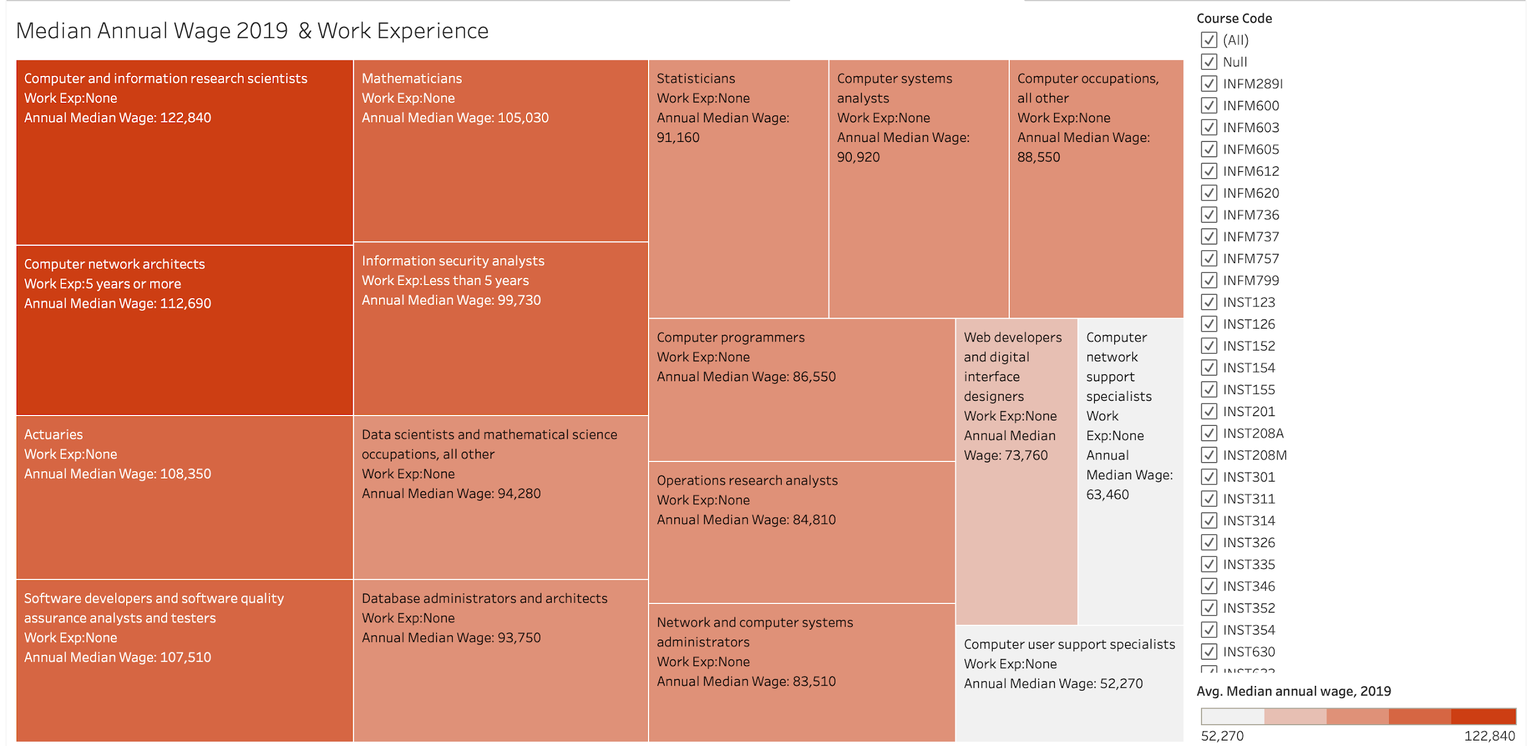
Tableau Report: Median Annual Wage 2019 & Work Experience
The highest paid positions in the Median Annual Wage report for 2019 belonged to Computer & Information Research Scientists and Computer Network Scientists at $122,840 and $112,690, respectively.
Notes:
Speaker Notes: This tableau report is comparing the annual wage to the work experience required for these particular occupations. These occupations are tied to the courses in the Ischool; the occupations for those particular courses. The key is highlighting that darker orange is a higher annual wage, and as the colors get lighter the median annual wage decreases. This chart also compares the work experience required for these occupations. For some occupations such as the “Computer and information research scientists” there is no work experience required but that occupation makes the highest annual median wage.

Slide 12
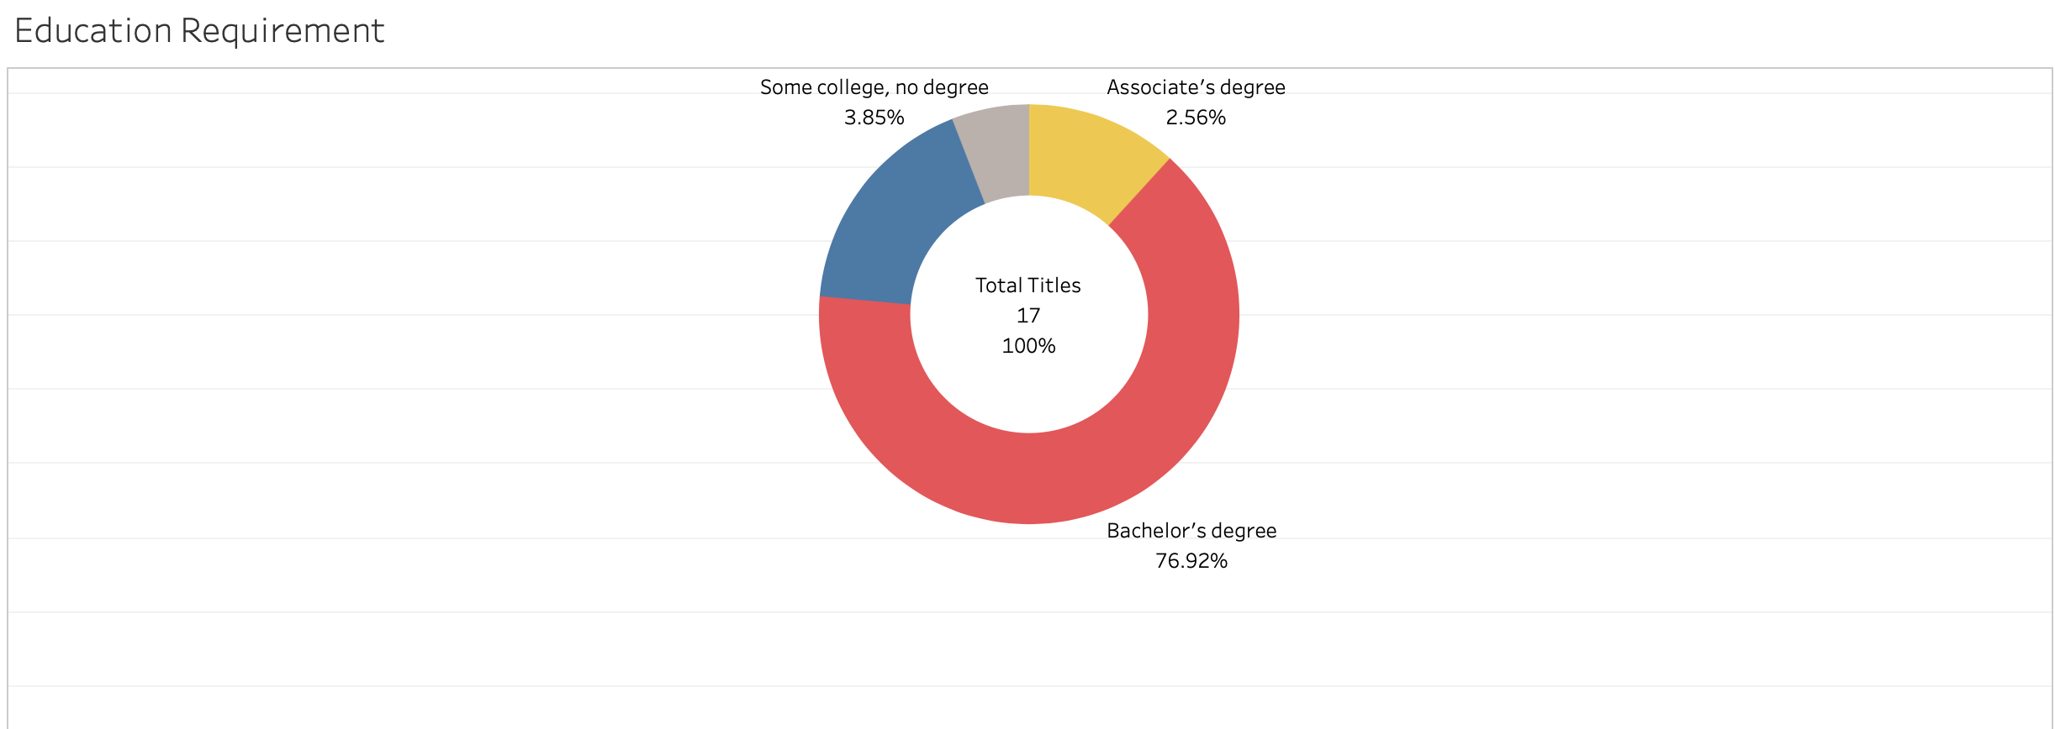
Educational Requirement
Based on this Tableau report, the reader sees that 76.92 percent of these occupation titles require a Bachelor's degree. There are 16.67 percent that require a Master’s degree for the specific job title. While 3.85 percent require some-to-no college degree; 2.56 percent require an Associate’s degree.

Slide 13
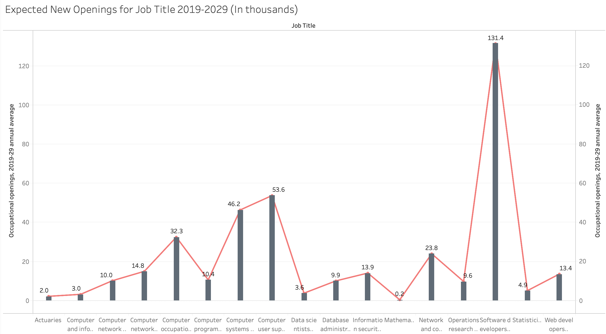
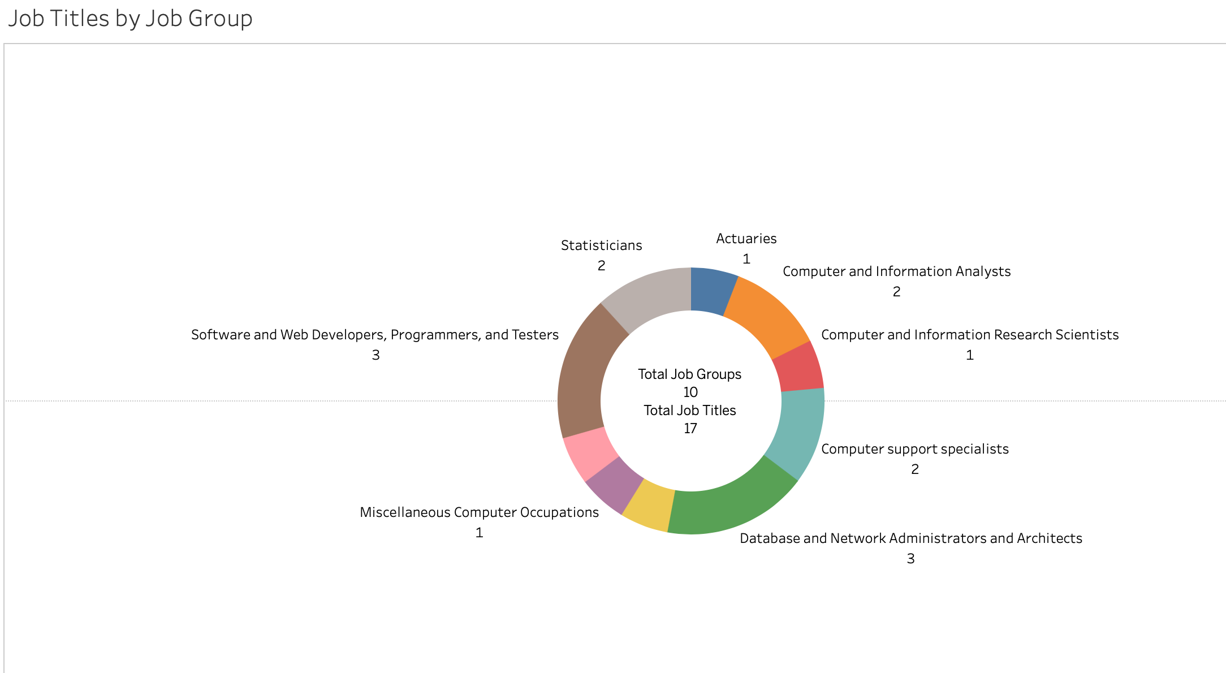
Tableau Report
There were 17 job titles, grouped into 10 groups. The chart to left is projecting the expected new openings within these job titles from 2019-2029. The numbers above the chart are a description of the amount of jobs that will be open within that given title for the expected years (2020-2029).

Slide 14
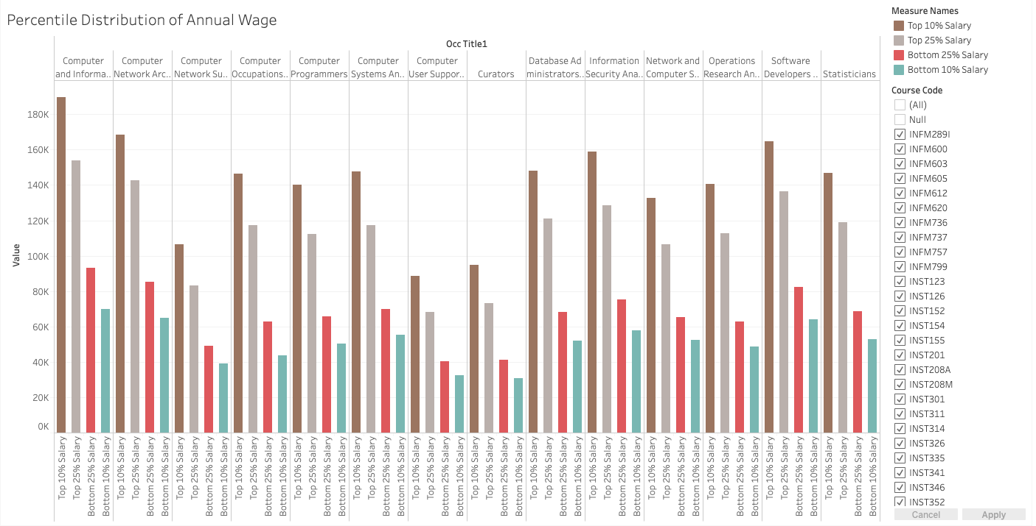
Percentile Annual Wage Distribution
This graph shows that Computer and Information Systems Professionals, and Software Developers were the top titles with highest salaries among top 10 % earning professionals. This confirms that the STEM field still fares well in the professional realm.

Slide 15
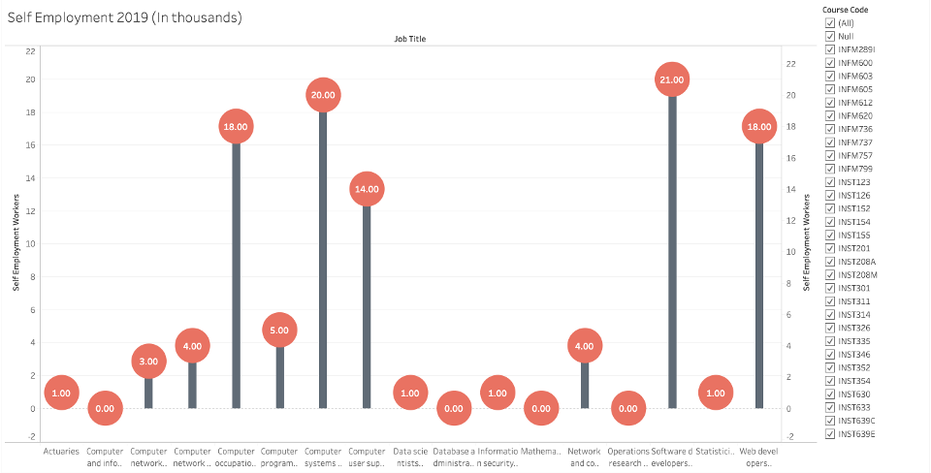
Self-Employment
Self-Employment has seen a major upward shift over the past few years, but 2019 has some of the highest marks yet. These workers did not find jobs under conventional working standards, but the demand for career control is becoming more prominent.

Slide 16
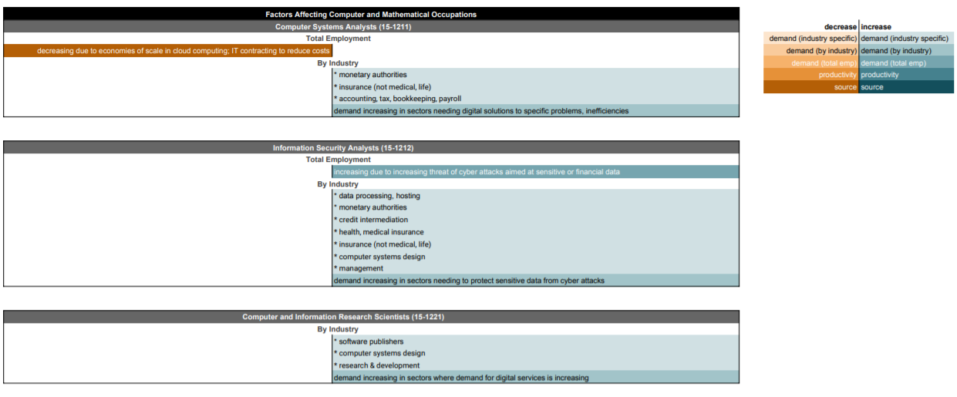
Factors Affecting Occupations

Slide 17
Envisioning the integration with iSchool
To implement of this service in existing process at the iSchool, following enhancements are expected in the serviceP:
Programs like MIM and HCIM have some predefined core courses , therefore we envision this service to be helpful in selection of appropriate elective courses and not modify the core courses structure of the programs.
We acknowledge that job requirements change fairly quickly than any course curriculum, and not all courses are targeted towards specific Job title, as some are focused on special areas of research and community well being.
To manage this temporal difference, this service should be owned by a department that works closely with career services and Instructional design. Department of this type would best at quickly identifying and bridging this gap.
To put this into real perspective, we see a department can be a combination of Teaching and Learning Transformation Center at UMD and UMD Career Center.

Slide 18
Thank You

